Slide 1
Abstract Factory Design Pattern

Slide 2
Abstract Factory Pattern
one level of abstraction higher than the factory pattern
to provide an interface for creating families of related objects, without specifying concrete classes.
return one of the related class of objects

Slide 3
Advantages
Exchanging products families easily
Isolation of concrete classes
code is made reusable and extensible
Best known example:
“look-and-feel”

Slide 4



Example(Demo)

Slide 5
Implementation
Factory Method
Prototype
Builder

Slide 6
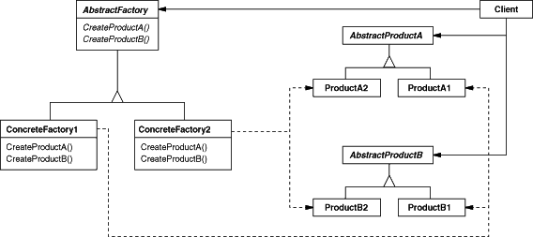
Example UML

Slide 7
Example Classes
* SaladInstructionsKit.java - (AbstractFactory)
* DicedGreekSaladInstructionFactory.java - (ConcreteFactory)
* SlicedGreekSaladInstructionFactory.java - (ConcreteFactory)
* CucumberInstructions.java - (AbstractProduct)
* TomatoInstructions.java - (AbstractProduct)
* SlicedTomatoInstructions.java - (ConcreteProduct)
* DicedCucumberInstructions.java - (ConcreteProduct)
* DicedTomatoInstructions.java - (ConcreteProduct)
* SlicedCucumberInstructions.java - (ConcreteProduct)
* GreekSaladInstructionsClient.java - (Client)
* MainClass.java - (class contains main method)

Slide 8
Disadvantages
Adding new factory is hard so supporting new products is difficult.
Adding new property to the factory is also hard.

Slide 9
References
http://www.davenicolette.net/articles/abstract_factory_pattern.png
http://www.allapplabs.com/java_design_patterns/abstract_factory_pattern.htm
http://sourcemaking.com/design_patterns/abstract_factory
http://en.wikipedia.org/wiki/Abstract_factory_pattern
http://www.patterndepot.com/put/8/AbstractFactory.PDF
http://www.javadesign.info/DesignConcepts/DesignPatterns/GOF/abstractfactory_pattern

